Slide 1
Recognizing Reader’s Affect Using EEG Data
Researcher: Kristine Kalaw
Adviser: Ms. Ethel Ong

Slide 2
Outline of the Presentation
Research Description
Review of Related Literature
Research Methodology

Slide 3


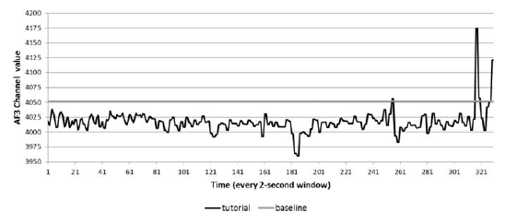
Introduction
© Walt Disney Pictures / Pixar Animation Studios / Inside Out (2015), Azcaraga & Suarez (2013) , Scholastic Corporation / J.K. Rowling / Harry Potter (1997-2007)

Slide 4
There is no current work that has studied brainwave patterns and their association to affect while a person is reading literary fiction.
Research Problem

Slide 5
Objectives / Scope and Limitations

Slide 6
To build an affect model that associates the EEG signals collected from readers (while they are reading stories) to specific emotions.
General Objective

Slide 7
Specific Objective #1
Objective
Scope and Limitation
To review the approaches, methodologies, and experiments of existing affect detection or recognition studies that uses EEG data;
A review of existing affect detection or recognition studies that uses EEG data.

Slide 8
Specific Objective #2
Objective
Scope and Limitation
To identify the different emotions the can be elicited from the readers by the stories;
A review of different emotion models and determine which of them is appropriate for reader affect.

Slide 9
Specific Objective #3
Objective
Scope and Limitation
To build a corpus of EEG signals;
The participants will be people of ages between 18 to 25
They will read pre-selected short stories while an EEG sensor is attached to them
The set-up of Miall and Kuiken (1994) will be used as basis

Slide 10
Specific Objective #4
Objective
Scope and Limitation
To determine which elements of a story affects the reader's emotional state;
The study will attempt to determine which element of the story triggered the reader to evoke that emotion.
character traits and behavior
reader's empathy to the character
the story plot or casual chain of story events
lexical choices and sentence structure.

Slide 11
Specific Objective #5
Objective
Scope and Limitation
To implement supervised and unsupervised machine learning algorithms for classifying the emotion based on the EEG signals;
A review of related literature to identify unsupervised or supervised classification techniques best suited for the data

Slide 12
Specific Objective #6
Objective
Scope and Limitation
To define evaluation metrics for assessing the performance of the model;
Precision
Recall
F-measure

Slide 13
Research Significance

Slide 14
Affective Computing
Affective Computing
Wearable computing
Computer Vision
Pattern Recognition
Machine Learning
Digital Signal Processing
Human-Computer Interaction
Explore the feasibility and application of these existing areas on an unexplored domain.

Slide 15
Methodology and Experiments
Data Collection
Data Preparation
Pre-processing
Classification
Serve as basis and reference for related future studies.

Slide 16
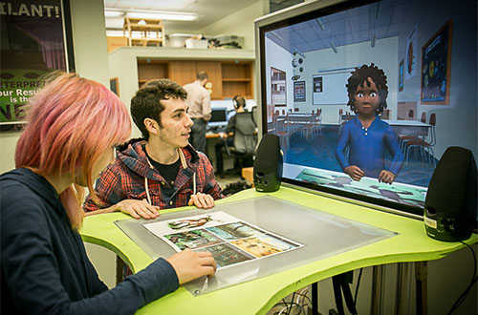
Affect-Related Systems
Results of this study can be further utilized in intelligent tutoring systems (ITS) or embodied conversational agents (ECA).
© ArticuLab / Carnegie Mellon University / Project Alex

Slide 17

Beyond Computer Science…
The findings of this work may be informative to affective science, psychology, and other related fields.
© Open University

Slide 18
Review of Related Literature

Slide 19
Emotions and Computing
Definition of emotions (Kleinginna Jr. and Kleinginna, 1981)
Relevance of emotions as proven in neurology (Bechara et al., 2000) and social psychology (Schwarz, 2000)
Emotional intelligence (Salovey and Mayer, 1990)
Affective computing, affect recognition, and challenges in affective computing (Picard, 1997;2000;2003)

Slide 20
Five Factors on Obtaining Good Affect Data
Subject-elicited vs. event-elicited | Does subject purposefully elicit emotion or is it elicited by a stimulus or situation outside the subject's efforts?
Lab setting vs. real-world | Is subject in a lab or in a special room that is not their usual environment?
Expression vs. feeling | Is the emphasis on external expression or on internal feeling?
Open-recording vs. hidden-recording | Does subject know that anything is being recorded?
Emotion-purpose vs. other-purpose | Does subject know that the experiment is about emotion?
© Picard (2000)

Slide 21
Emotions and Brainwaves
Azcarraga and Suarez (2013)
confidence, excitement, frustration, and interest
event-elicited, lab-setting, feeling, open-recorded, emotion-purpose
Multi-Layered Perceptron (MLP) and Support Vector Machines (SVM)
precision, accuracy, F-measure

Slide 22
Emotions and Reading Fiction
The act of reading and its importance (Freire & Slover, 1983; Mar et al., 2009; Kidd and Castano, 2013; Vezzali et al., 2015)
Reader-response criticism (Tompkins, 1980)
Taxonomy of narrative emotions (Oatley, 1995; Mar et al., 2011)

Slide 23
Taxonomy of Emotions
Emotions of Literary Response
Resulting from accommodation of schema, from dishabituation, new connections, insights
Resulting from assimilation to schema, e.g. curiosity about what will happen next
Emotions of Sympathy
Emotion memories
(relived/remembered)
Emotions of Identification
Emotions of Empathy

Slide 24
Emotions and Reading Fiction
Miall and Kuiken (1994)
3 literary stories divided roughly into equal segments using phrase and sentence divisions while still retaining meaningful units as far as possible (approx. 77-86 segments per story).
Employed 1st and 2nd reading
2nd reading: story segments are presented again one at a time, with reference to the two previous and succeeding segments, then rate the segments based on strikingness (1 to 5 scale) and affect (no feeling to strong feeling).

Slide 25
Research Methodology
Activities | JAN | FEB | MAR | APR | MAY | JUN | JUL | AUG | SEP | OCT | NOV | DEC
(1) | **** | **** | **** | **_ _
(2) |  |  | _ _** | **_ _ | **_ _
(3) |  |  |  |  | _ _** | **** | **_ _ |  | _*** | ****
(4) |  |  |  |  |  |  | **** | ***_ | _*** | **** | **_ _
(5) | _ _** | **** | **** | **_ _ | **** | **** | **** | ***_ | _*** | **** | **** | *_ _ _
Concept Formulation and Review of Related Literature
Development of Data Collector Tool
Data Collection and Corpus Building
Training and Evaluation
Documentation

